Slide 1
E-Assessment
Azhar ul islam

Slide 2
contents
Introduction to E-Assessment
Benefits of E-Assessment
Problems of E-Assessment
E-Assessment at your disposal
Questions

Slide 3


Typical learning and assessment today?

Slide 4
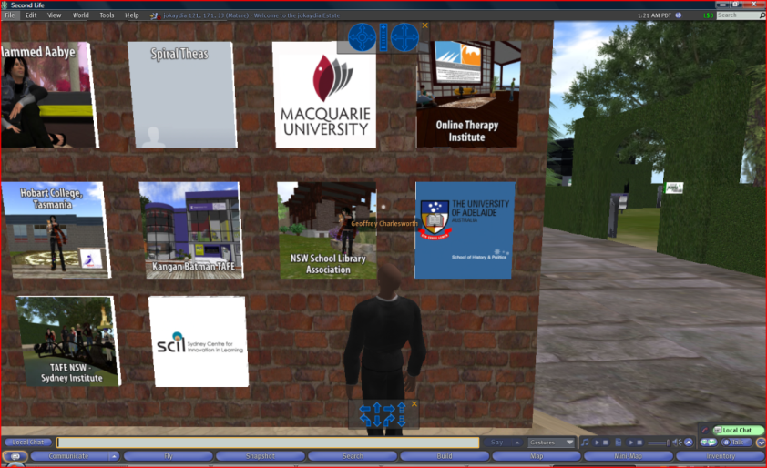

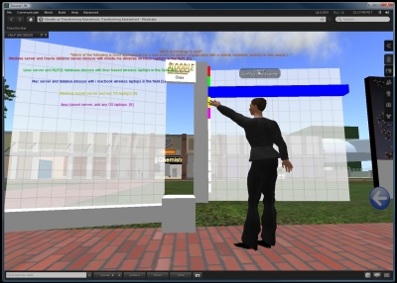
New learning environments for students and teachers

Slide 5
Introduction
Assessment undertaken via a computer
Desktop computer
Laptop computer
PDA
Smartphone
Formative or summative

Slide 6
Benefits of E-Assessment
Easier to administer with individual candidates
Potentially greater security
Potentially wider examination “windows”
Easier to manage verification processes
Faster turnaround of results and reporting
Potentially easier to deal with support and accessibility issues for learners with specific needs

Slide 7
Problems of E-Assessment
Staffing requirements (e-testing role matrix)
Areas of responsibility
Generic tasks
E-testing processes and procedures
Liaison
Resources
Problem solving
Learner support
Staff development/capability

Slide 8
E-Assessment at your disposal
Modules of MOODLE LMS
Assignments
Online Exam using Question Banks
Forum participation
Virtual Classroom

Slide 9

Questions?

Slide 10

Do you want the red pill or the blue pill?

Slide 11
Azhar ul islam
Assistant System Programmer Directorate of Overseas Education & e-Learning Room G-5, ICT Building, AIOU
Email: azhar@aiou.edu.pk
URL: olive.aiou.edu.pk
URL: del.aiou.edu.pk
URL: col.aiou.edu.pk

